Slide 1
Watchlist

Slide 2
Watchlist
Screener
Backtest
Live Trading
Watch list | Coins | Edit List | Delete List
LaelaCoinbase | 7 | Edit | Delete
AY Jaseel | 60 | Edit | Delete
Fire | 30 | Edit | Delete
Create Watchlist

Slide 3
Watchlist
Screener
Backtest
Live Trading
Laela Coinbase
Add to List
Delete List
ADAUSDT,RENUSDT,PIAOUSDT
S/No | Watch list | Open | High | Low | Close | Delete
1 | BTCUSDT | 12 | 12 | 12 | 12
2 | ADAUSDT | 12 | 12 | 12 | 12
3 | JNJUSDT | 60 | 60 | 60 | 60
4 | AAPLYUSDT | 30 | 30 | 30 | 30
5 | PIAOUSDT | 12 | 12 | 12 | 12
6 | REXUSDT | 60 | 60 | 60 | 60
7 | AYUSDT | 30 | 30 | 30 | 30
Cancel
Save
Cancel
Save

Slide 4
Screener

Slide 5
Watchlist
Screener
Backtest
Live Trading
Watchlist
Historical Screen
Fire
12/8/2020
Filter 1
Filter Limit
Sort Type
Close[0]/Close[2]
10
Ascending
Filter 2
Filter Limit
Sort Type
NATR[2]
3
Descending
Screen Name
Email Daily Screen to
Save Screen
Tester
abeyusuf@gmail.com
Save
Run Screen
Notes:
1. This shall allow for daily run of screener to see instruments that match criteria

Slide 6
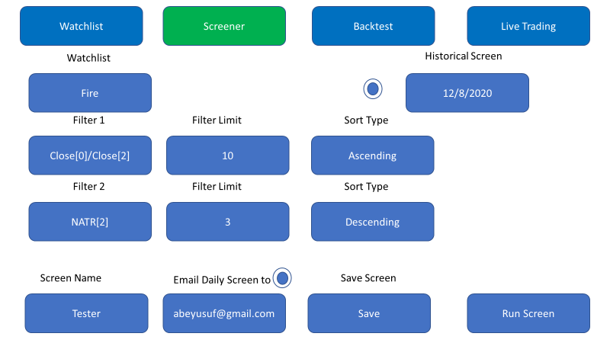
Screen Name: TerstScreen Date: 22/11/2021
Coin | Open | High | Low | Close
YoYoUSDT | 1 | 2 | 2 | 1
RENUSDT | 1 | 2 | 2 | 1
RENUSDT | 1 | 2 | 2 | 1

Slide 7
Backtest

Slide 8
Watchlist
Screener
Backtest
Live Trading
Watchlist
Backtest Period
Fire
12/8/2020
12/8/2020
Filter 1
Filter Limit
Sort Type
Close[0]/Close[2]
10
Ascending
Filter 2
Filter Limit
Sort Type
NATR[2]
3
Descending
Scaling
Rebalance
Profit Target %
Trade Duration
10
None
500
10 days
Strategy Name
PiaoChicken
Save as New Strategy
Backtest Log
Backtest

Slide 9
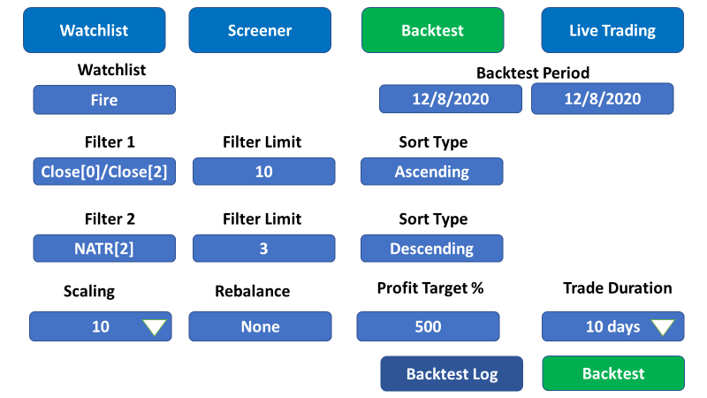
Strategy
Filter 1:NATR[1] Filter Limit:12 Sort Typee:Ascending
Filter 2:Close[0]/Close[1] Filter Limit: 3 Sort Type: Descending
Backtest Period: 2020-01-01 ~ 2021-05-05
Profit: 5 Scaling: 1
Rebalance: quarterly
Expire: 92 Days Total Trade: 61
Final Account Balance: 24290.912750541567 Total Profit: 23290.912750541567
Capital Growth: 2329.091275054157 % Profit Factor: 3881.818791756928 Profit Trade: 90.1639344262295 %
Coin | Entry Date | Entry Price | Entry Quantity | First Result | Entry Amount | Exit Date | Exit Amount | Exit Signal
YoYoU |  | 1 | 2 |  |  | 2 | 1 | Duration
RENU |  | 1 | 2 |  |  | 2 | 1 | Profit
RENU |  | 1 | 2 |  |  | 2 | 1 | Backtest

Slide 10
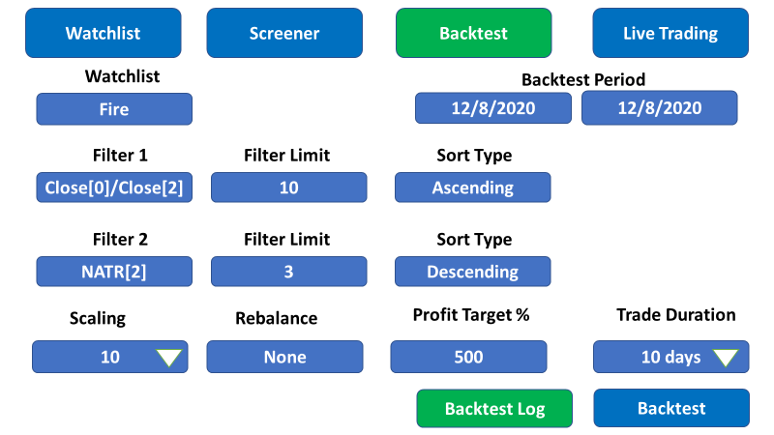
S/No | Strategy | Filter 1 | Filter 1 Sort | Filter 1 Limit | Filter 2 | Filter 2 Sort | Filter 2 Limit | Scaling | Rebalance | Profit Target% | Trade Duration | Profit Trades | Profit Ratio | Total Profit
1 | Piao |  | 2 |  |  | 2 | 1 | Duration
2 |  | 1 | 2 |  |  | 2 | 1 | Profit
3 |  | 1 | 2 |  |  | 2 | 1 | Backtest

Slide 11
Livetrading

Slide 12
Strategy Name
API Key
Strategy Performance
PiaoChicken
PiaoChicken
10 days
Notes:
User is able to select a strategy setting from Backtest page and strategy is loaded here. User selects API key to trade an account on Binance or coinbase. Clicking strategy performance shall show you performance of strategy and all trades on the Binance or Coinbase App

Slide 13
Notes
All Data should be saved daily automatically to the DB

